Slide 1
Advanced Pattern Matching in C#
Oliver Sturm

Slide 2
Agenda
01
02
03
C# Pattern Matching Feature Evolution
Less Obvious
Use Cases
Use C# but Be Like Haskell

Slide 3
01
C# Pattern Matching Feature Evolution

Slide 4
C# 7
value is Type t
… even in switch!

Slide 5
C# 8
Switch expressions
Property pattern
Positional pattern (tupel, deconstruction)

Slide 6
C# 9
Logical patterns
Relational patterns
Structural enhancements

Slide 7
C# 10
Nested property pattern

Slide 8
C# 11
Span<char>
List patterns

Slide 9
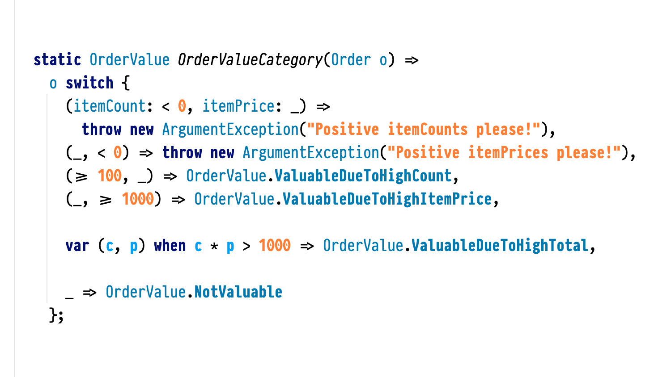

Slide 10
02
Less Obvious Use Cases

Slide 11
Four quick examples
Construct tuples on the fly
Replace ternary expressions
Combine match patterns
Deal with Comparer<T>

Slide 12
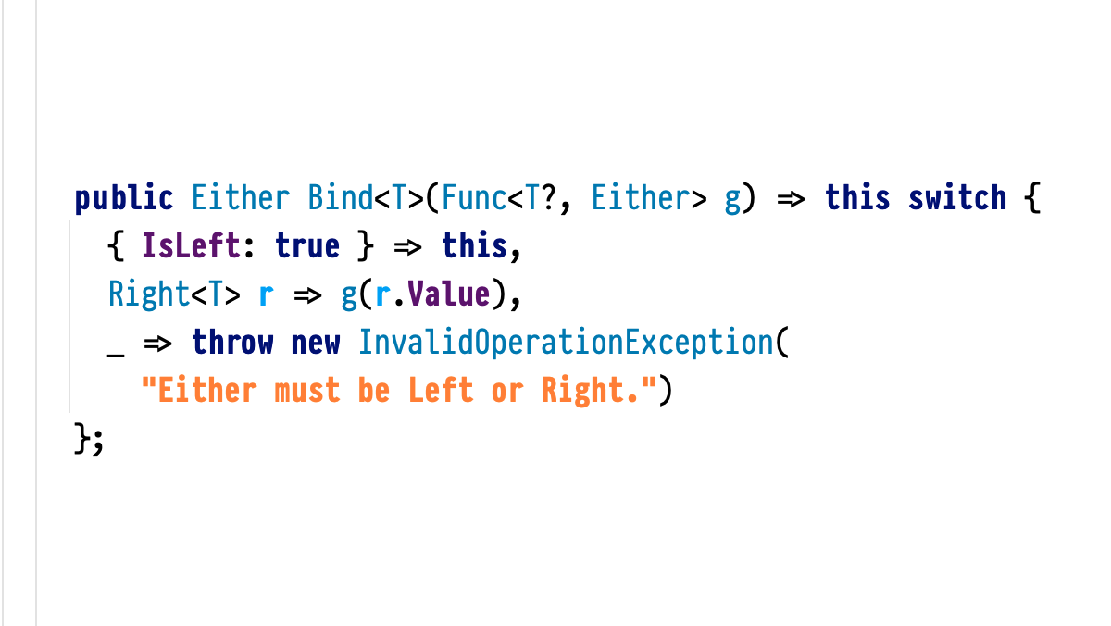

Slide 13
03
Use C# but Be Like Haskell

Slide 14

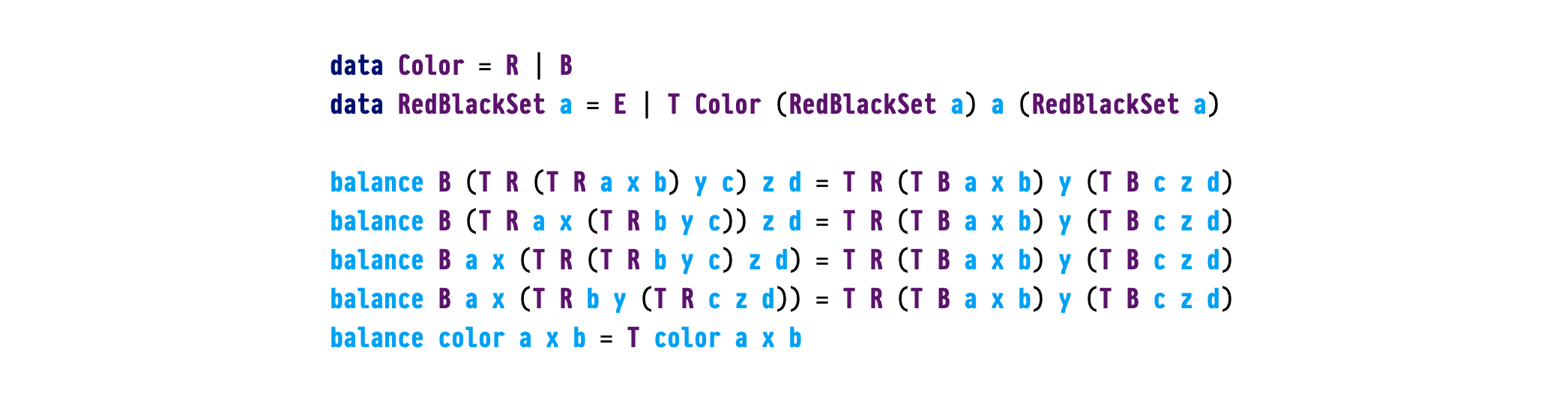

Slide 15
Resources
https://github.com/oliversturm/advanced-pattern-matching-cs-samples
Pattern matching sample code
https://github.com/oliversturm/FCSlib
Functional C# Library with Haskell-style match sample

Slide 16

Get .NET 9
Download .NET 9 aka.ms/get-dotnet-9

Slide 17
Thank you

